Slide 1
NCDA Credentialing
Sherry R. Williams
SCCDA President-Elect
November 2018

Slide 2
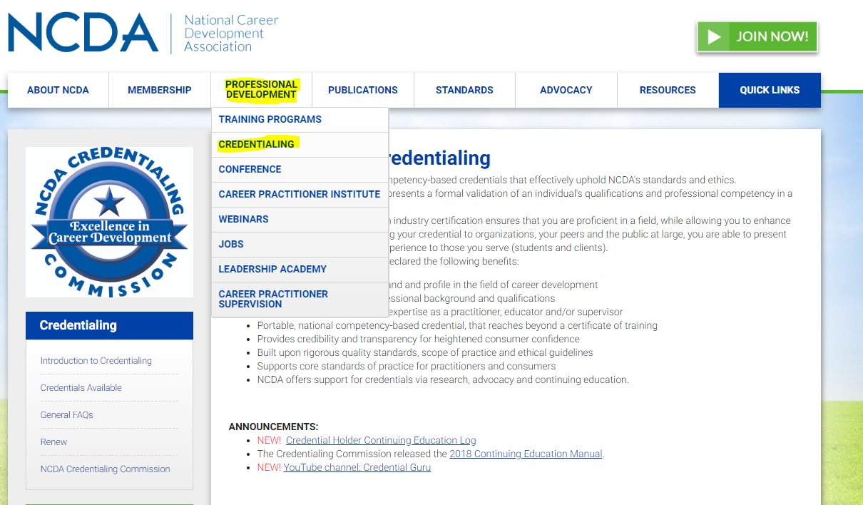

Slide 3
Credential
Credential
A credential is the highest level of proof supporting an individual's educational or professional achievement. The credential is issued by a third party with authoritative power and is proof of an individual's qualification or competence in a given subject.
Certification
A certificate is awarded for completion of an educational program to gain knowledge in a specific area.
Example: certificate for completion of FCD 120 hour course.

Slide 4
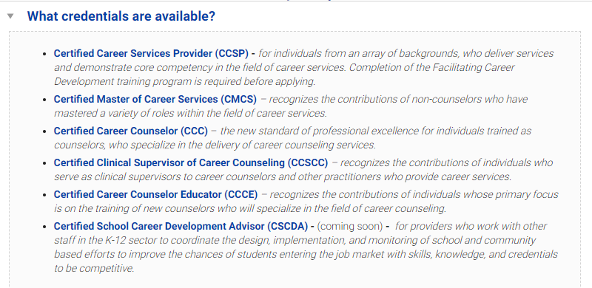

Slide 5
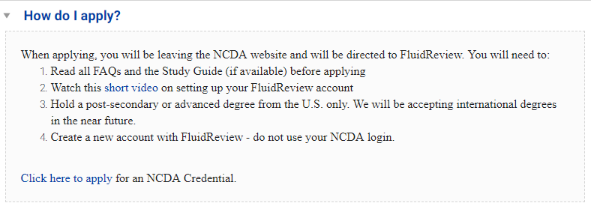

Slide 6
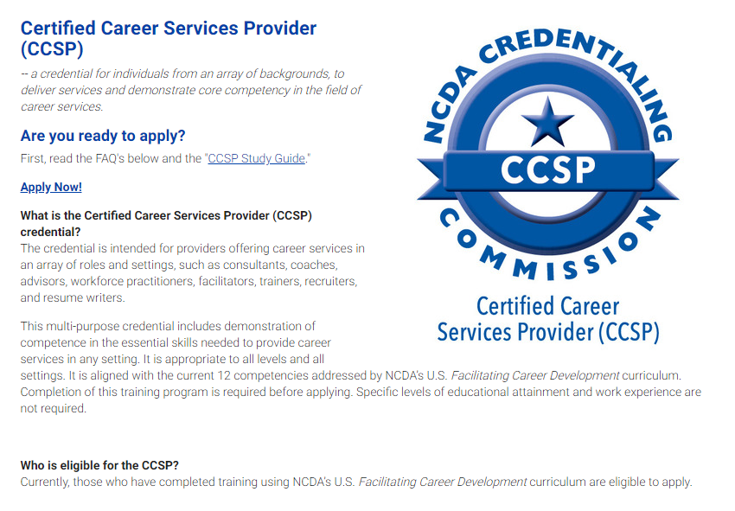

Slide 7
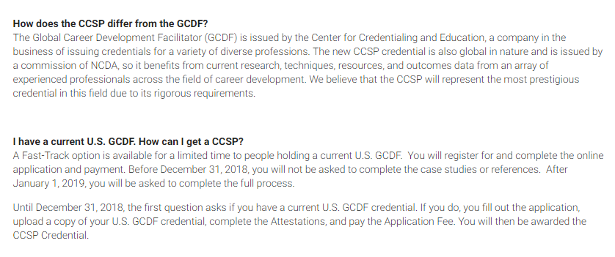

Slide 8
Comparison
GCDF
CCSP
Application Cost | $100
Annual fee | $40
Recertification timeframe | Every 5 years
Hours | 75
Education and Experience hours to apply | Grad: 1400 Bachelors: 2800
Text | FCD 120 hr course
Application cost | $100
Annual fee | $40
Recertification timeframe | Every 3 years
Hours | 30
Education and Experience | Must complete 4 scenarios appropriate to the credential area
Text | FCD 120 hr course

